Slide 1
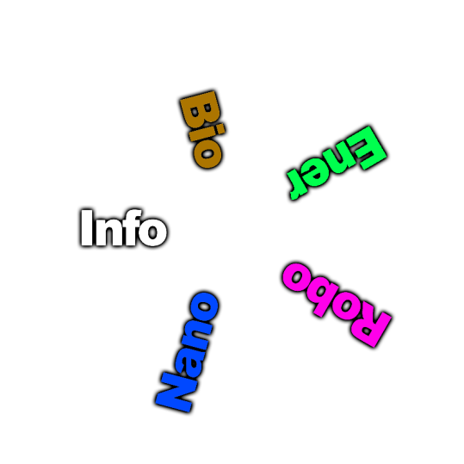
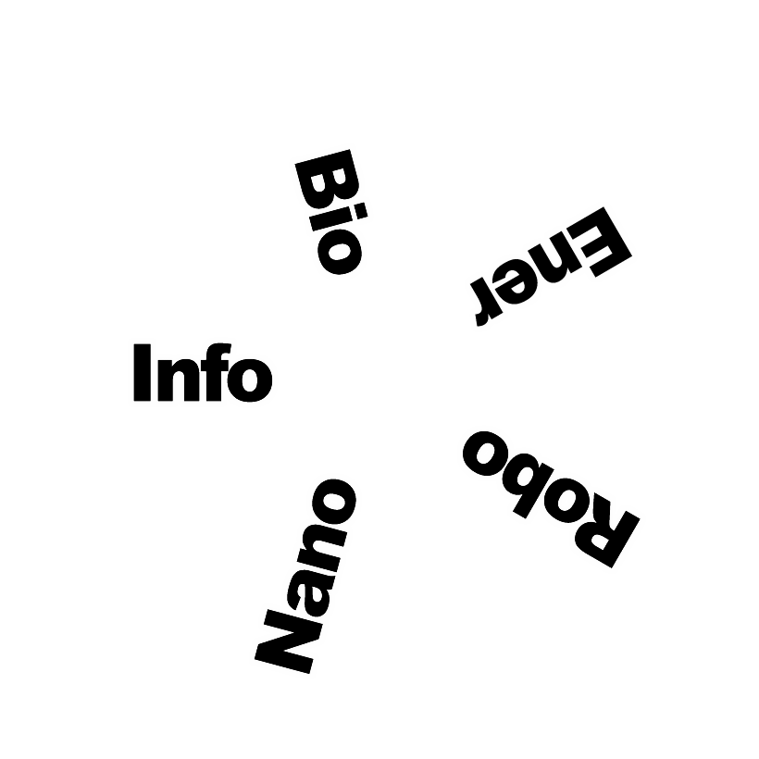
Bits, Atoms, Cells, Gears & Joules
The Five Forces Driving the Next Techno-Socio-Economic Revolution
August 2014
Jeff Wacker
Principal Futurist
JLWFutures

Slide 2
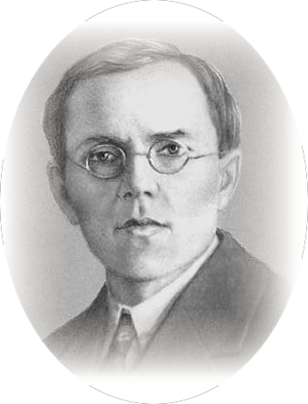
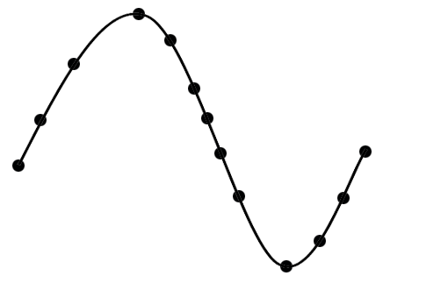
Kondratieff Cycles
Euphoria
Anxiety
MATURITY
Thrill
SYNERGY
Denial
Optimism
Fear
Professor Nickolai Kondratieff
(1892-1938)
FRENZY
Technology Diffusion
Desperation
Optimism
Excitement
Panic
Relief
ERUPTION
Hope
Despondency
Time
Big Bang
Crash
Recovery and Transition
Copyright JLWFutures 2014

Slide 3
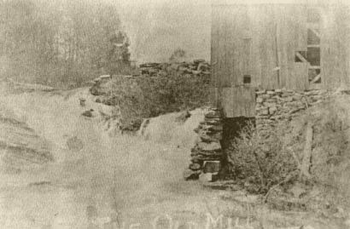
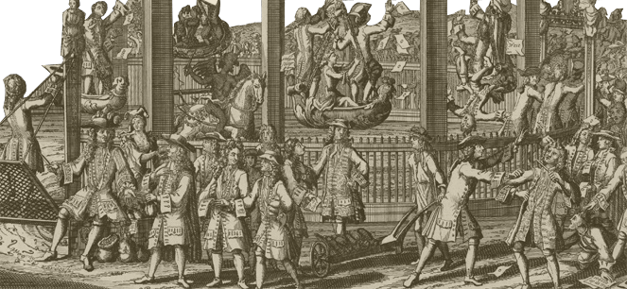
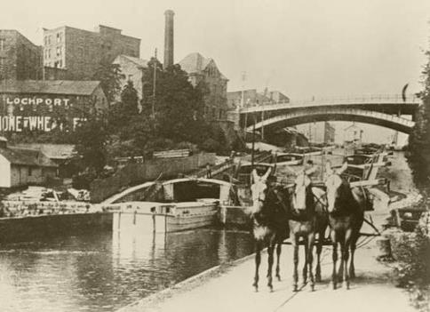
Kondratieff Cycles
Cycle 1: Industrial Revolution 1771-1829
1771 Industrial Revolution
Canal Panic 1797 (Britain)
Diffusion of manufacturing with water power
Full network of waterways (canals, rivers, oceans)
Development of public companies
Copyright JLWFutures 2014

Slide 4
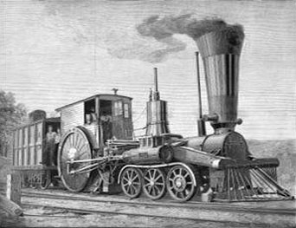
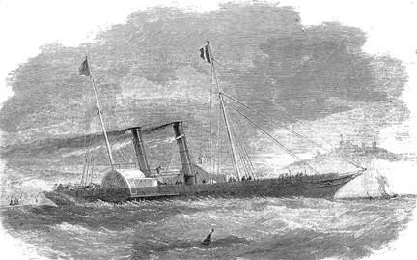
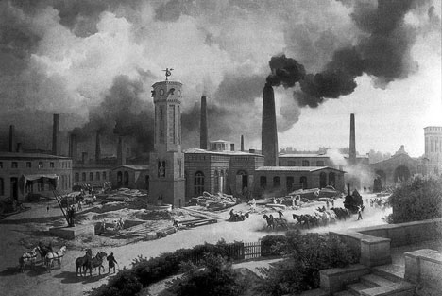
Kondratieff Cycles
Cycle 2: Steam and Railways 1829-1875
1829 Steam & Railways
Railway Panic 1847 (Britain)
Economies of scale
Joint stock companies
Repeal of tariff laws/free trade
Copyright JLWFutures 2014

Slide 5
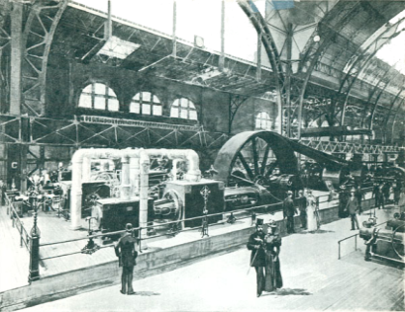
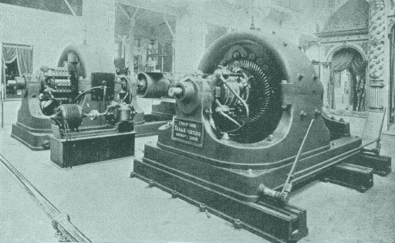
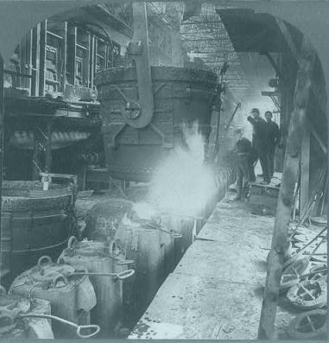
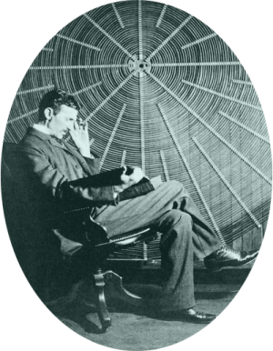
Kondratieff Cycles
Cycle 3: Steel, Electricity & Heavy Engineering 1875-1908
1875 Steel, Electricity
& Heavy Engineering
Global collapses
Of the 1890’s
(Argentina,
Australia, U.S.)
Transcontinental rail, steamships and telegraph
Gold standard, global finance
Copyright JLWFutures 2014

Slide 6
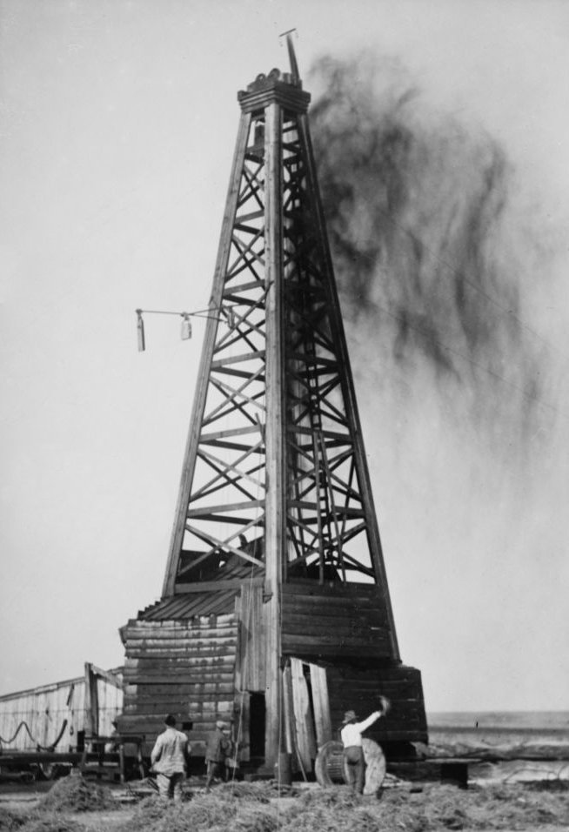
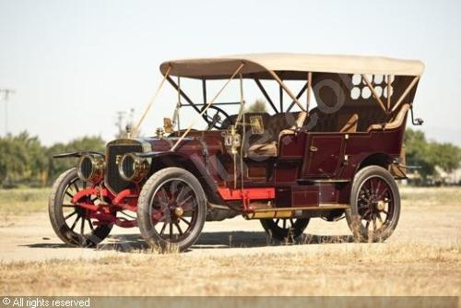
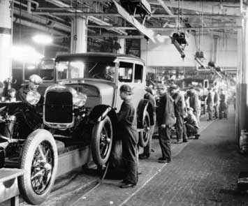
Kondratieff Cycles
Cycle 4: Automobiles, Oil & Mass Production 1908-1966
1908 Automobiles, Oil
& Mass Production
Great Crash
Of 1929
(U.S.)
Interstate/international highways and airways
Welfare state, Bretton Woods, IMF, World Bank
Copyright JLWFutures 2014

Slide 7
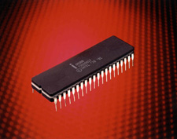
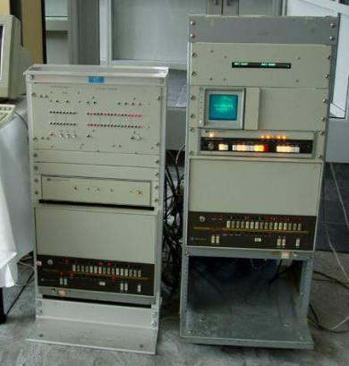
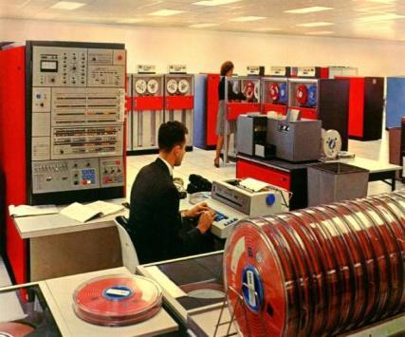
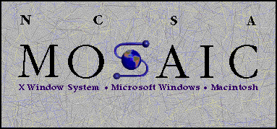
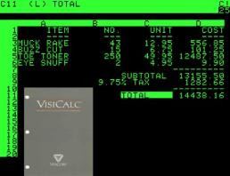
Kondratieff Cycles
Cycle 5: Information & Telecommunications 1966~2016
1966 Information &
Telecommunications
NASDAQ
Crash 2000 &
Global Collapses
(ASIA, Argentina, U.S.)
Global digital telecommunications network
Institutional framework, facilitating globalization
Copyright JLWFutures 2014

Slide 8
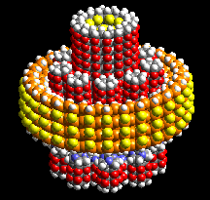
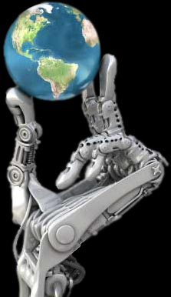
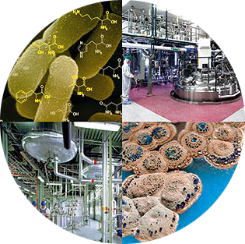
Kondratieff Cycles
Cycle 6: InfoTech2, NanoTech, BioTech, RoboTech, EnerTech
Copyright JLWFutures 2014

Slide 9
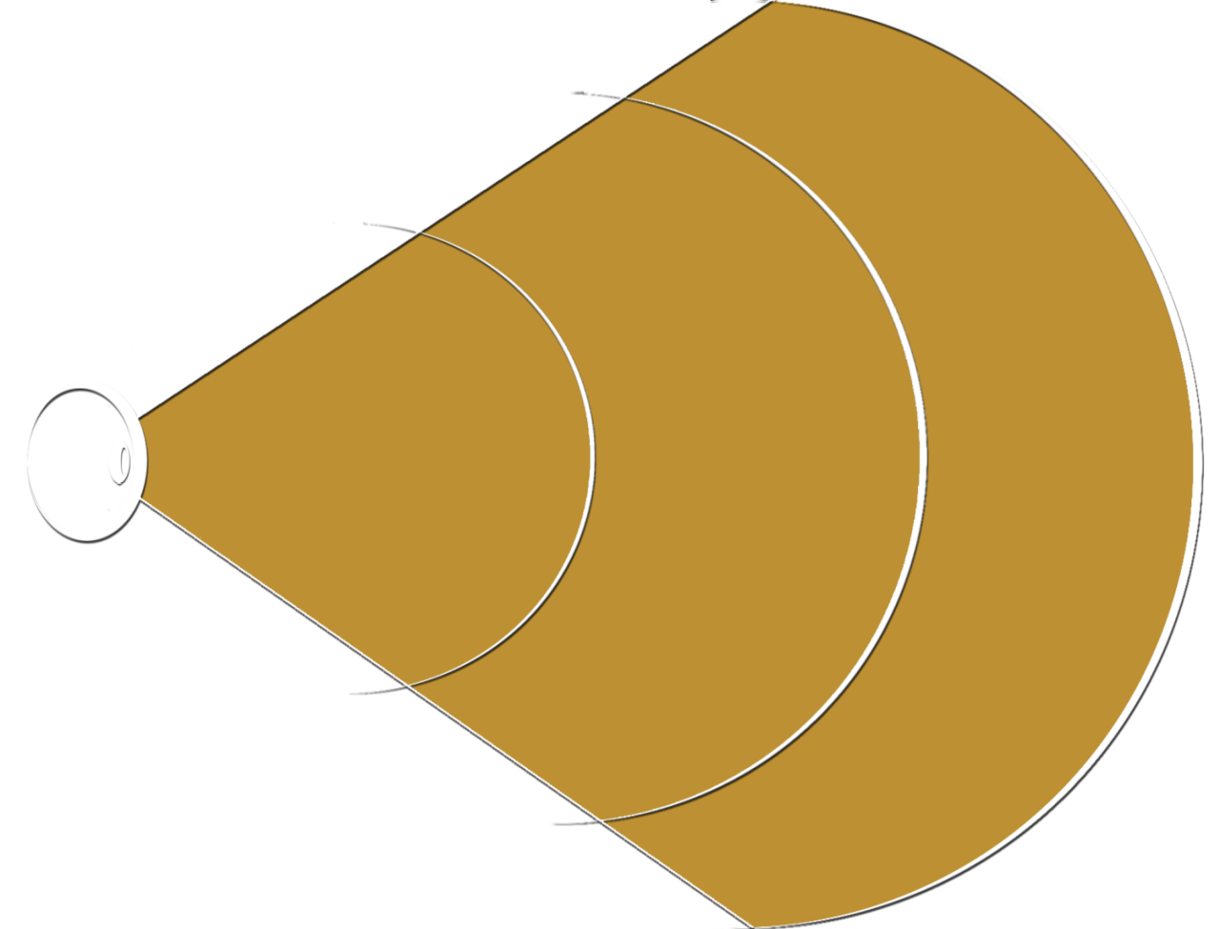
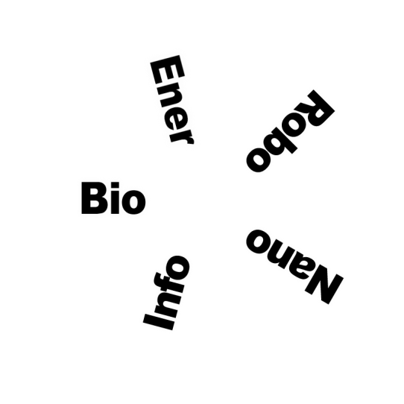
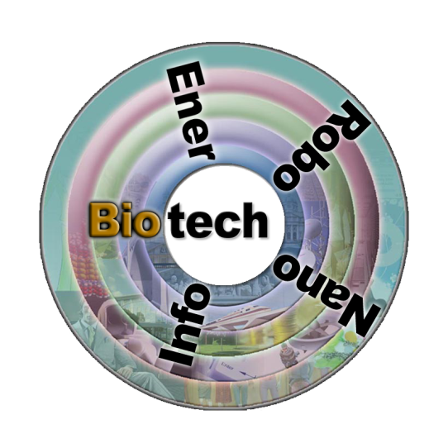
BioTechnology
Regeneration
bioPrinted Organs
Synthetic Biology
GM Foods
Designer Lifeforms
Cloning
de-Extintion
(Humans)
DNA Computing
Fully augmented Species
Copyright JLWFutures 2014

Slide 10
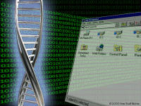
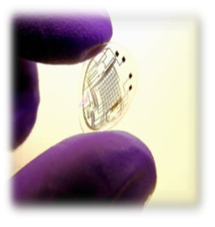
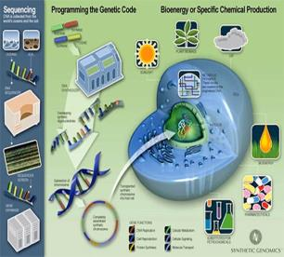
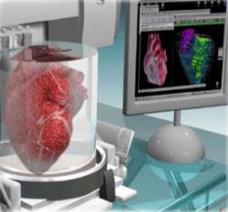
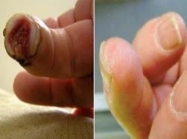
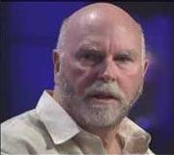
BioTechnology
Unintended Consequences
Moral ethics
New bioWeapons
Copyright JLWFutures 2014

Slide 11
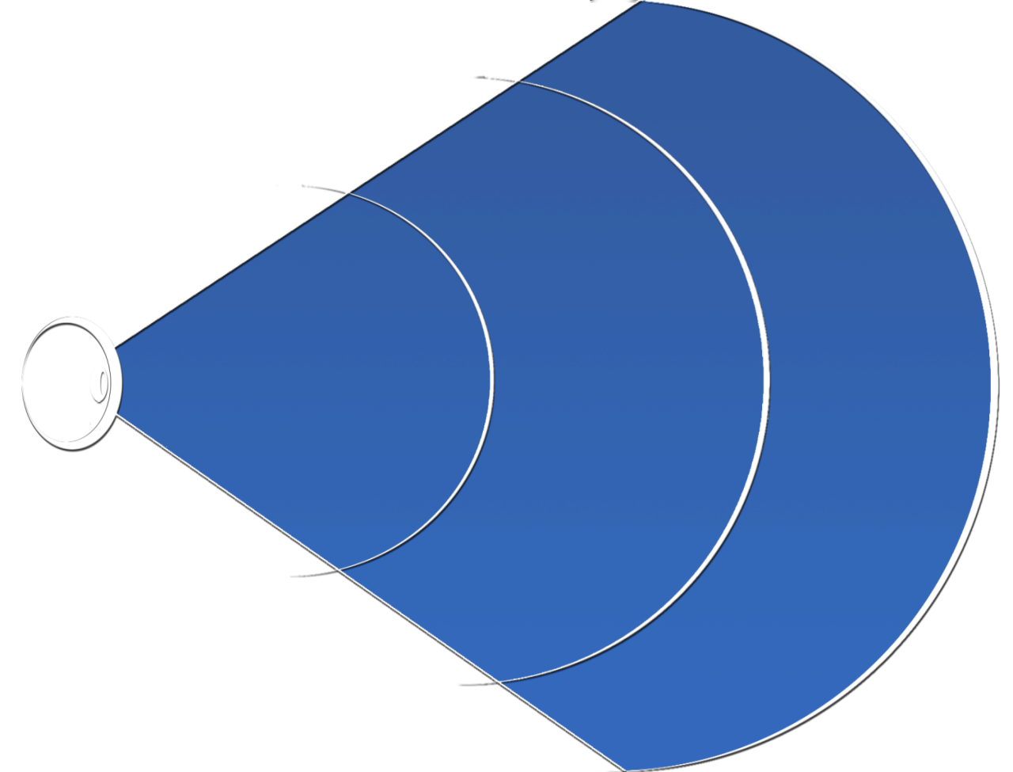
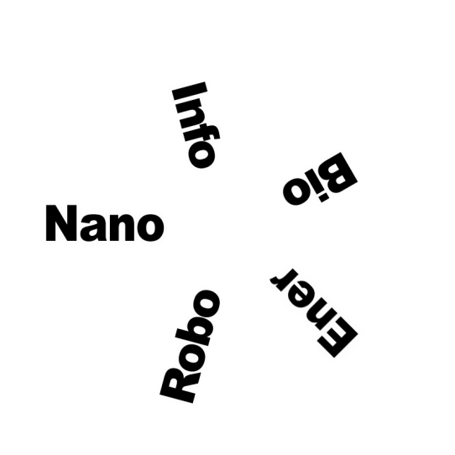
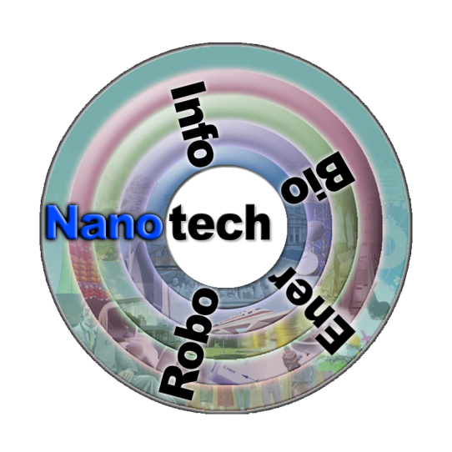
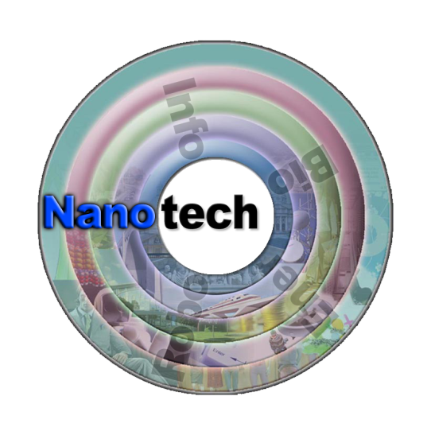
Nano Technology
Ultra-X
Homogenous
Nanites
nanoSensors
Heterogenous
Self-assembly of nanoelectronic components
nanoReplication
Copyright JLWFutures 2014

Slide 12
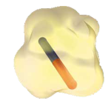
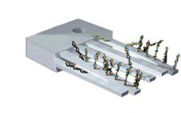
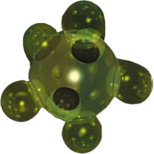
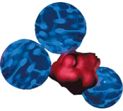
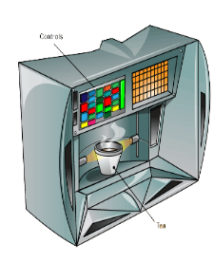
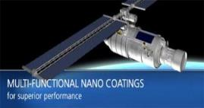
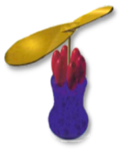
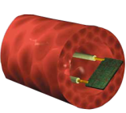
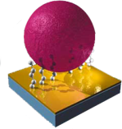
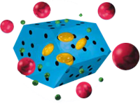
Nano Technology
Potential toxicity
Binary nanoWeapons
Raw materials Availability
Grey Goo
Glowing Report
Smart Bomb
Medicine Cabinet
Seek and Destroy
Power Pack
Tiny Turbine
Cell Control
molecular manufacturing
Alien Invasion
Copyright JLWFutures 2014

Slide 13
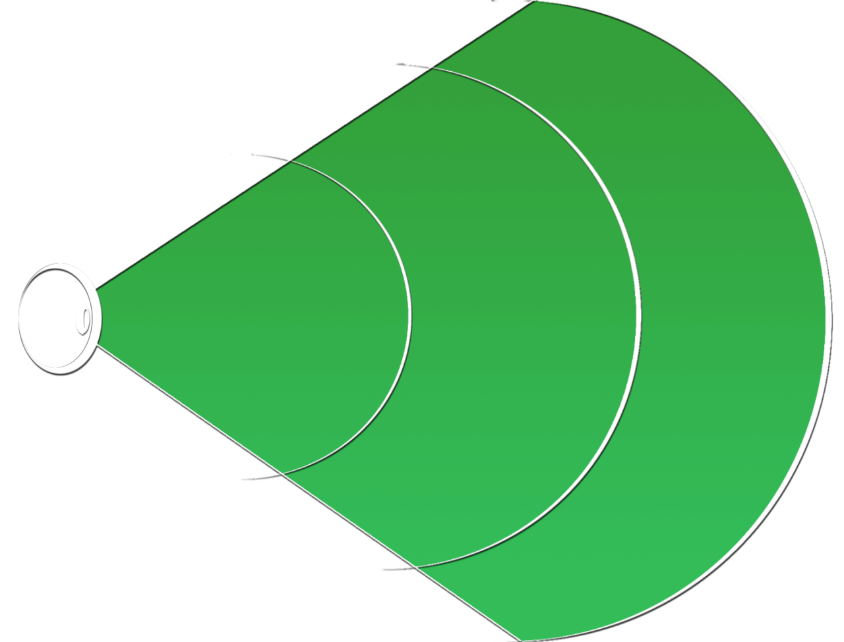
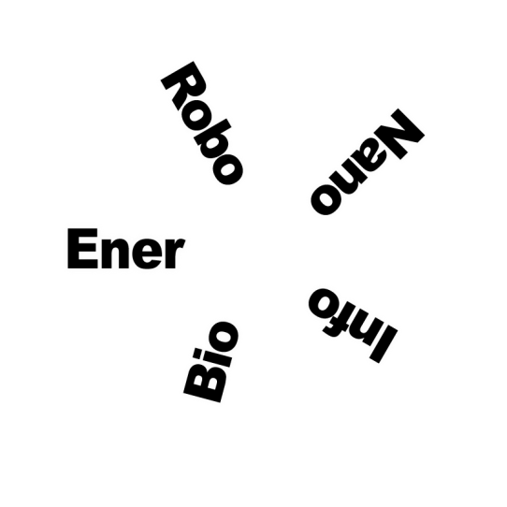
Energy Technology
Fossil Fuels
Macro
Renewable Sources
Distributed Generation
Conservation
Alternative, Alternative Sources
Ultrapure Batteries
Conservation
Micro
Parasitic Power
nanoGenerators
Copyright JLWFutures 2014

Slide 14
Energy Technology
Unrestricted growth
New source for weapons
Moderate jobs outlook
Thermopower waves
Traveling Wave Nuclear Power
Multiferroic Alloy
Copyright JLWFutures 2014

Slide 15
Robotics Technology
Immobots
Process Automation
Modeling & Simulation
Expert Systems
True AI
warbots
factorybots
Mobots
Non-humanoid form factors
serviceBots
xxxBots
Robot-built Robots
Copyright JLWFutures 2014

Slide 16
Robotics Technology
Role of humans?
New battlefields
Negative jobs outlook
Expert
Systems
Modeling & Simulation
Memristors & Neuromorphic Computing
Copyright JLWFutures 2014

Slide 17
Robotics Technology
Desensitivity to War
xRobot
“Terminator”
Negative Jobs Outlook
Copyright JLWFutures 2014

Slide 18
Information Technology 2
“Presence” interfaces
Overt
Pervasive IT
Ubiquitous IT
Discrete
Exponential IT
Mobile
Self-assembly of nanoelectronic components
Computer-designed computers
Copyright JLWFutures 2014

Slide 19
Information Technology 2
Quantum Computing
Memristors & Neuromorphic Computing
2D to 3D Architectures
Photonic Computing
Copyright JLWFutures 2014
Notes:
We show that the entanglement dynamics for the pure state of a closed two-qubit system is part of a 10-dimensional complex linear differential equation defined on a supersphere, and the coefficients therein are completely determined by the system Hamiltonian. We apply the result to two physical examples of Josephson junction qubits and exchange Hamiltonians, deriving analytic solutions for the time evolution of entanglement. The Hamiltonian coefficients determine whether the entanglement is periodic. These results allow of investigating how to generate and manipulate entanglements efficiently, which are required by both quantum computation and quantum communication.

Slide 20
Information Technology 2
Privacy!
TMI
Dependence
Loss of Control
Cyber-Warfare
Copyright JLWFutures 2014

Slide 21
Challenges & Opportunities
Increased Challenges/Opportunity From:
Information Overload
Security Concerns
Environmental Disruptions
Globalization
Geopolitical Events
Sustainability
Resource Management
Energy Costs
Regulations
Rapid Social Shifts

Slide 22
Recommended Reading on these topics
Abundance: The Future is Better Than You Think*
- Peter Diamandis & Steven Kotler
Radical Abundance: How a Revolution in Nanotechnology will Change Civilization
- K. Eric Drexler
Singularity Rising: Surviving and Thriving in a Smarter, Richer and More Dangerous World - James D. Miller
Race Against the Machine: How the Digital Revolution is Accelerating Innovation, Driving Productivity, and Irreversibly Transforming Employment and the Economy
- Erik Brynjolfsson and Andrew McAfee
The Age of Context: Mobile, Sensors, Data and the Future of Privacy
- Robert Scoble & Shel Israel
- Newt Gingrich
* Read this one if you’re only going to read one - JLW
Copyright JLWFutures 2014

Slide 23
Q&A
jeffwacker@verizon.net
Copyright JLWFutures 2014

